Slide 1

Exploring factors affecting Medical Expenses
Barathwaaj, Bhavna, Pravin, Prashanth

Slide 2
Objective and Research Question
Occurrence of expensive health conditions that account towards high medical costs are seldom and hard to predict
Premiums set by insurance companies has a direct dependence on a person’s age, fitness, habits, history of illness etc.
We will try to explore and identify the relationship between BMI and Medical charges for people of different age groups and smoking habits
https://edu.kpfu.ru/pluginfile.php/278552/mod_resource/content/1/MachineLearningR__Brett_Lantz.pdf
https://www.kaggle.com/mirichoi0218/insurance

Slide 3
Data Description
This dataset, simulated using U.S. Census Bureau, approximates to real-world conditions thus helping us understand the research question. The file contains 1,338 examples of beneficiaries’ medical charges and their details for the calendar year.
Features:
Age
Sex
BMI
No of Children/Dependents
Smoker
Region
Target:
Medical Charges
https://edu.kpfu.ru/pluginfile.php/278552/mod_resource/content/1/MachineLearningR__Brett_Lantz.pdf
https://www.kaggle.com/mirichoi0218/insurance

Slide 4
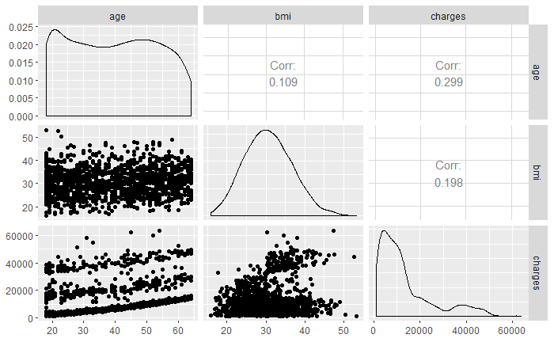

Slide 5
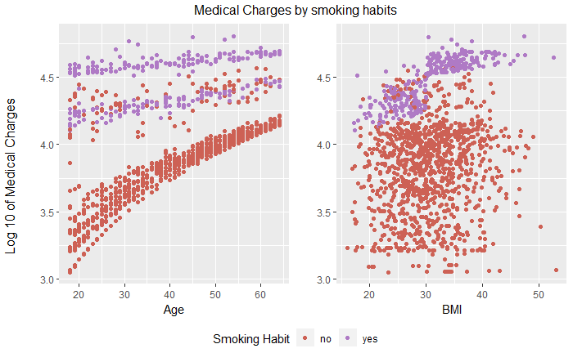
Charges vs Age/BMI

Slide 6
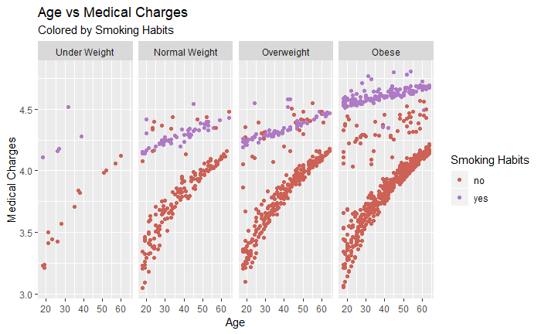
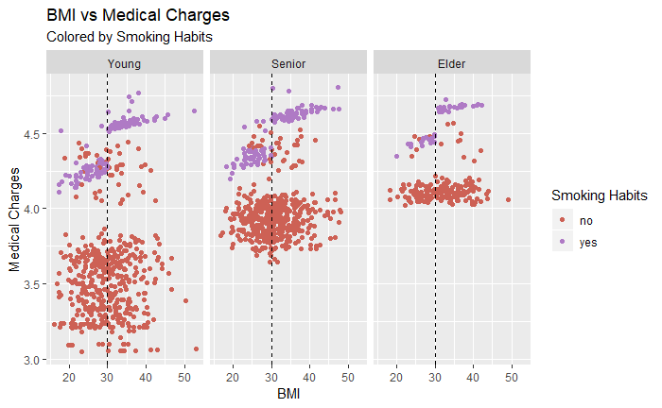
Charges v/s BMI-Age Categories
Notes:
The extracted data is a transaction level data of Google Analytics belonging to the E-Commerce Domain. The data contains 903653 transactions and 55 Features.Out of these 55 features, 12 are numerical and 43 are categorical(including binary).

Slide 7
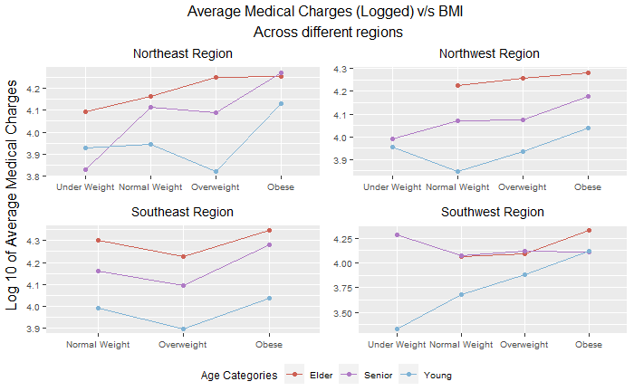
Charges v/s BMI with Age and Region

Slide 8


Loess Model
Medical Expenses
Age
BMI
Smoker
Sex

Slide 9
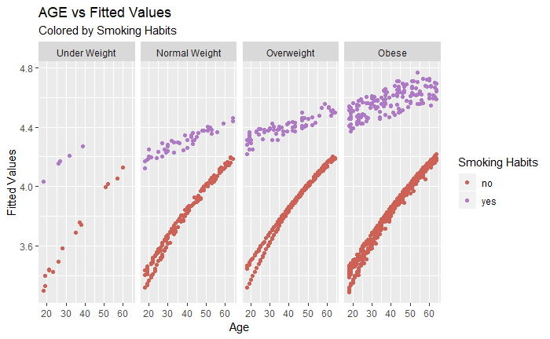
Fitted Values v/s Age with BMI Categories

Slide 10
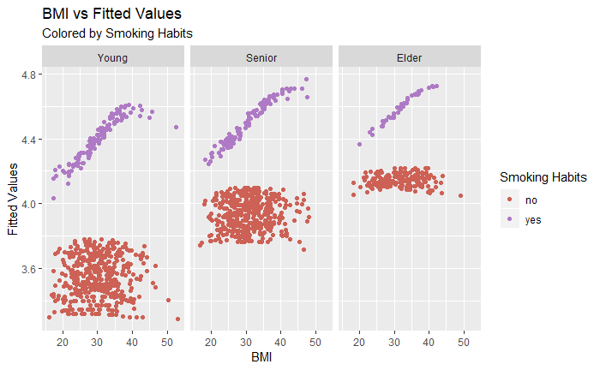
Fitted Values v/s BMI with Age Categories

Slide 11
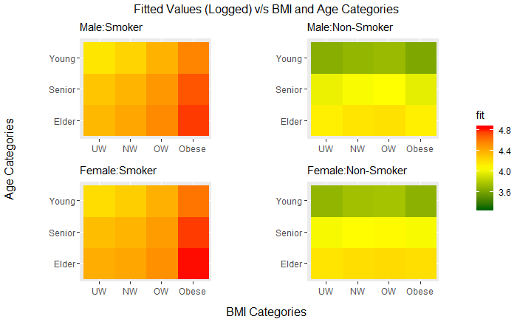
Fitted Values v/s BMI and Age Categories

Slide 12
Conclusion and Future Work
Clear and direct impact on medical charges with Age and BMI
Smoking habits elevates medical charges significantly
Could consider “Size of family” and it’s interactions

Slide 13
Thank You

Slide 14
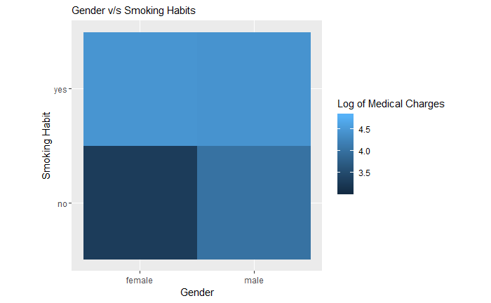
Appendix

